Slide 1



Hanbok Dress up Game
Android study

Slide 2
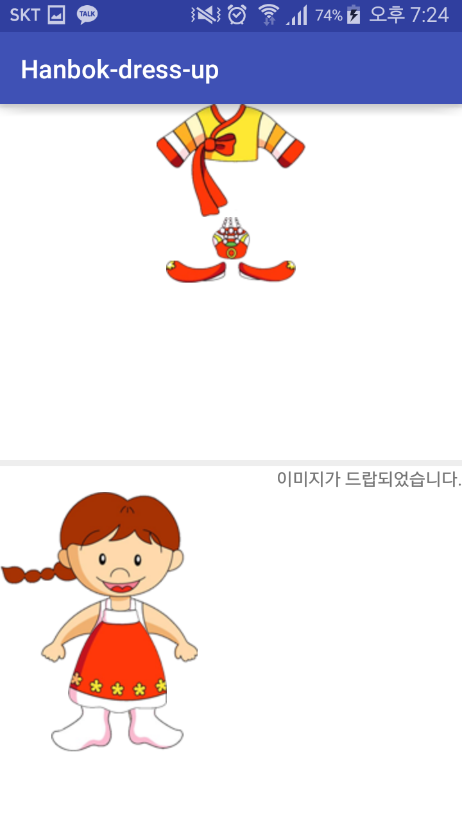
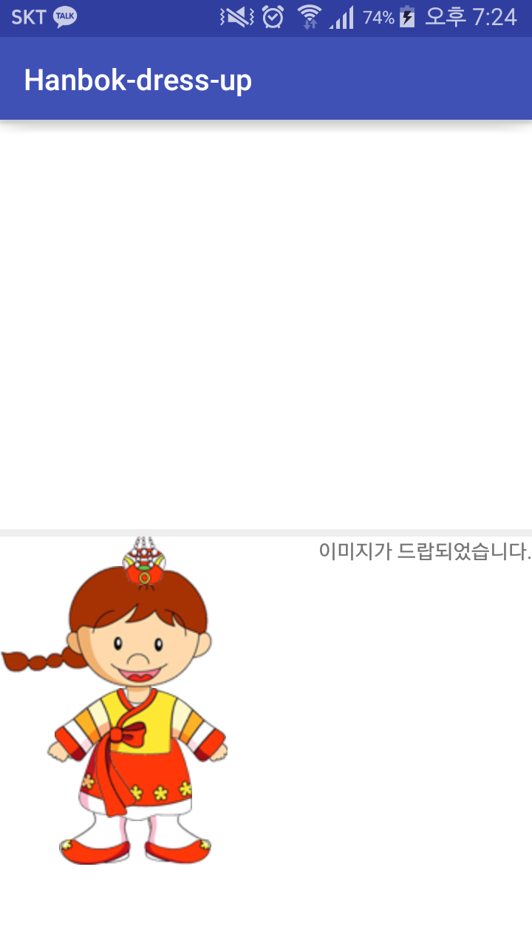
Goal

Slide 3
Callback method

Slide 4

Method of Toast class
Event occurs > Listener response > correspond callback method is called
View class
interface
callback method
Mom: Chulsu, Please come back home by PM 6:00
What time is it now?
It’s 4:00
It’s 4:30
It’s 4:38
It’s 5:01
Please don’t ask me again ☹

Slide 5

Method of Toast class
Event occurs > Listener response > correspond callback method is called
View class
interface
callback method
Mom: Chulsu, Please come back home by PM 6:00
Please tell me at PM 6:00
OK~☺
event
callback method

Slide 6
OnLongClickListener

Slide 7
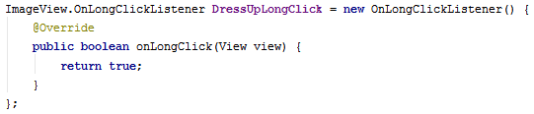
Method of OnLongClickListener interface
OnLongClick(View v) // abstract boolean

Slide 8
OnDragListener

Slide 9
Method of OnDragListener interface
onDrag (View v, DragEvent event)
// abstract boolean
Whenever you pick-up, move and drop the image.
This Listener will run.

Slide 10
DragEvent

Slide 11
Method of DragEvent class
getAction()
getLocalState()

Slide 12
Constant of DragEvent class
ACTION_DRAG_STARTED
ACTION_DRAG_ENTERED
ACTION_DRAG_EXITED
ACTION_DROP
ACTION_DRAG_ENDED

Slide 13


onDrag (View v, DragEvent event)
// abstract boolean
v = toplinear
event.getAction()
= ACTION_DRAG_STARTED
v = toplinear
event.getAction()
= ACTION_DRAG_STARTED

Slide 14
onDrag (View v, DragEvent event)
// abstract boolean
v = toplinear
event.getAction()
= ACTION_DRAG_ENTERED

Slide 15
onDrag (View v, DragEvent event)
// abstract boolean
v = toplinear
//default

Slide 16
onDrag (View v, DragEvent event)
// abstract boolean
v = toplinear
event.getAction()
= ACTION_DRAG_EXITED
v = bottomlinear
event.getAction()
= ACTION_DRAG_ENTERED

Slide 17
onDrag (View v, DragEvent event)
// abstract boolean
v = bottomlinear
event.getAction()
= ACTION_DROP

Slide 18
onDrag (View v, DragEvent event)
// abstract boolean
v = bottomlinear
event.getAction()
= ACTION_DRAG_ENDED
v = toplinear
event.getAction()
= ACTION_DRAG_ENDED

Slide 19
Controlling Dynamic View

Slide 20
Do you remember?
Without xml file, we can also make UI components
Button myButton = new Button(this);
RelativeLayout myLayout = new RelativeLayout(this);
myLayout.addView(myButton);
setContentView(myLayout);
myButton.setText(“Press Me”);
myButton.setBackgroundColor(Color.YELLOW);
myButton.setTransformationMethod(null);
PRESS ME
This is dynamic View !

Slide 21



Slide 22
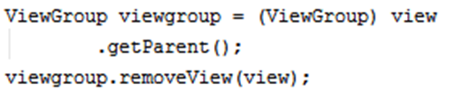
View
Event occurs here

Slide 23
View

Slide 24
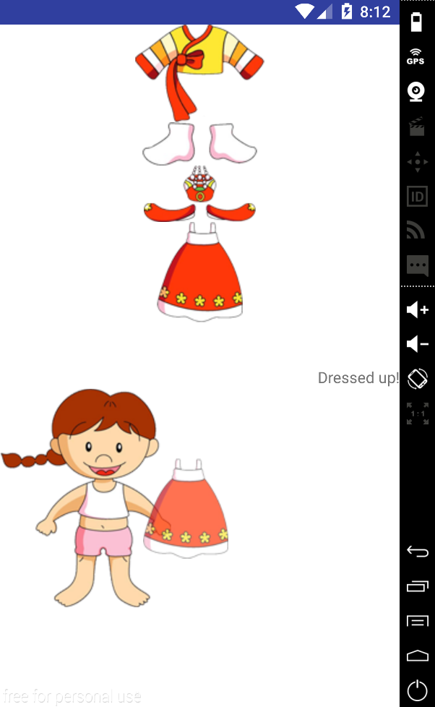
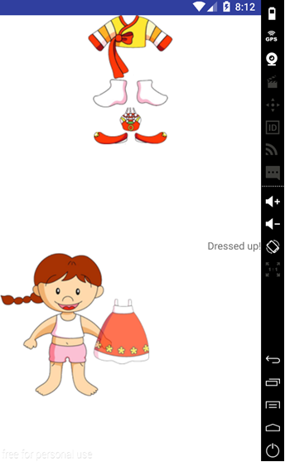

Slide 25
ClipData.Item

Slide 26

ClipData.Item
ClipData.Item is an object that holds the data to be delivered. Data to have a Text, Url, Intent. Through ClipData.Item generates ClipData.

Slide 27
ClipData.Item
Constructor of ClipData.Item class
ClipData.Item(CharSequence text)

Slide 28
ClipData

Slide 29

ClipData
The class to store
information in the Drag & Drop.

Slide 30
ClipData
Constructor of ClipData class
ClipData(CharSequence label, String[] mimeTypes, ClipData.Item item)
ClipData(ClipDescription description, ClipData.Item item)Create a new clip.
ClipData(ClipData other)

Slide 31
ClipDescription

Slide 32
Constant of ClipData class
MIMETYPE_TEXT_HTML
MIMETYPE_TEXT_INTENT MIMETYPE_TEXT_PLAIN
MIMETYPE_TEXT_URILIST

Slide 33
DragShadowBuilder

Slide 34
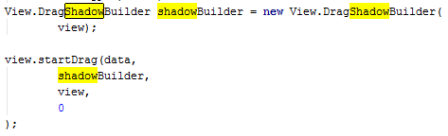
DragShadowBuilder
DragShadowBuilder using the pointer moves along the translucent image is dragged.

Slide 35
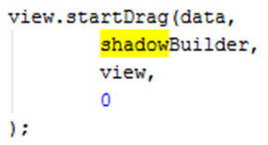
Constructor of DragShadowBuilder class
View.DragShadowBuilder(View view)
startDrag Method of View class
startDrag(ClipData data, View.DragShadowBuilder shadowBuilder, Object myLocalState, int flags)

Slide 36
Log

Slide 37
int d (String tag, String msg)

Slide 38

Download skeleton
https://github.com/daehwa/world-friends-Uzbekistan-android/

